Slide 1
Electronics 101

Slide 2
DISCLAIMER
At first, we will look at a very small subset of electrical engineering
Specifically, for the time being, we’re focusing on steady-state circuits
That is, everything stays the same over time; there are no pulses, for example, or sine waves, or signals
A lot of the things that I will say are wrong in the general sense
For example, “electricity can’t pass through an insulator”
Understand that these things are simplifications that make electronics easier to understand under specific circumstances, but are not always true
I’ll make it clear when I’m saying something that is a real, no-shit physical law (it’ll be in red)

Slide 3
The “Water Analogy”
Often, I’ll compare electrical processes and components to flowing water, pipes, etc.
Again, these are approximations that are intended to help give an intuitive understanding of electricity, but that shouldn’t be taken too far

Slide 4
Electrical Charge
Electrical charge is a measure of the “amount of electricity”
The SI unit of electrical charge is the coulomb
Symbol: Q
Unlike mass (as far as we know), charge is not absolute; it can be positive or negative
This is not a transient or relative property; you can absolutely just cram some coulombs into an object
This is basically what happens when you shuffle your feet on a carpet in dry weather
Water analogy: a Coulomb is a gallon of water

Slide 5
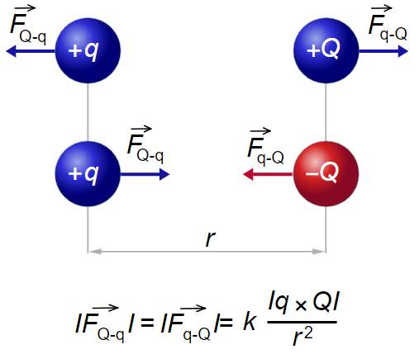

Electrical Charge
“Opposite charges attract; like charges repel”
Basic interpretation of Coulomb’s Law
May or may not be true for dating
More specifically: $\overset{⃑}{F}=k\frac{q_{1}q_{2}}{{\left|\overset{⃑}{r_{21}}\right|}^{2}}∙\hat{r_{21}}$
$k$ is “Coulomb’s constant”,
$$9∗{10}^{9}\frac{Nm^{2}}{C^{2}}$$

Slide 6
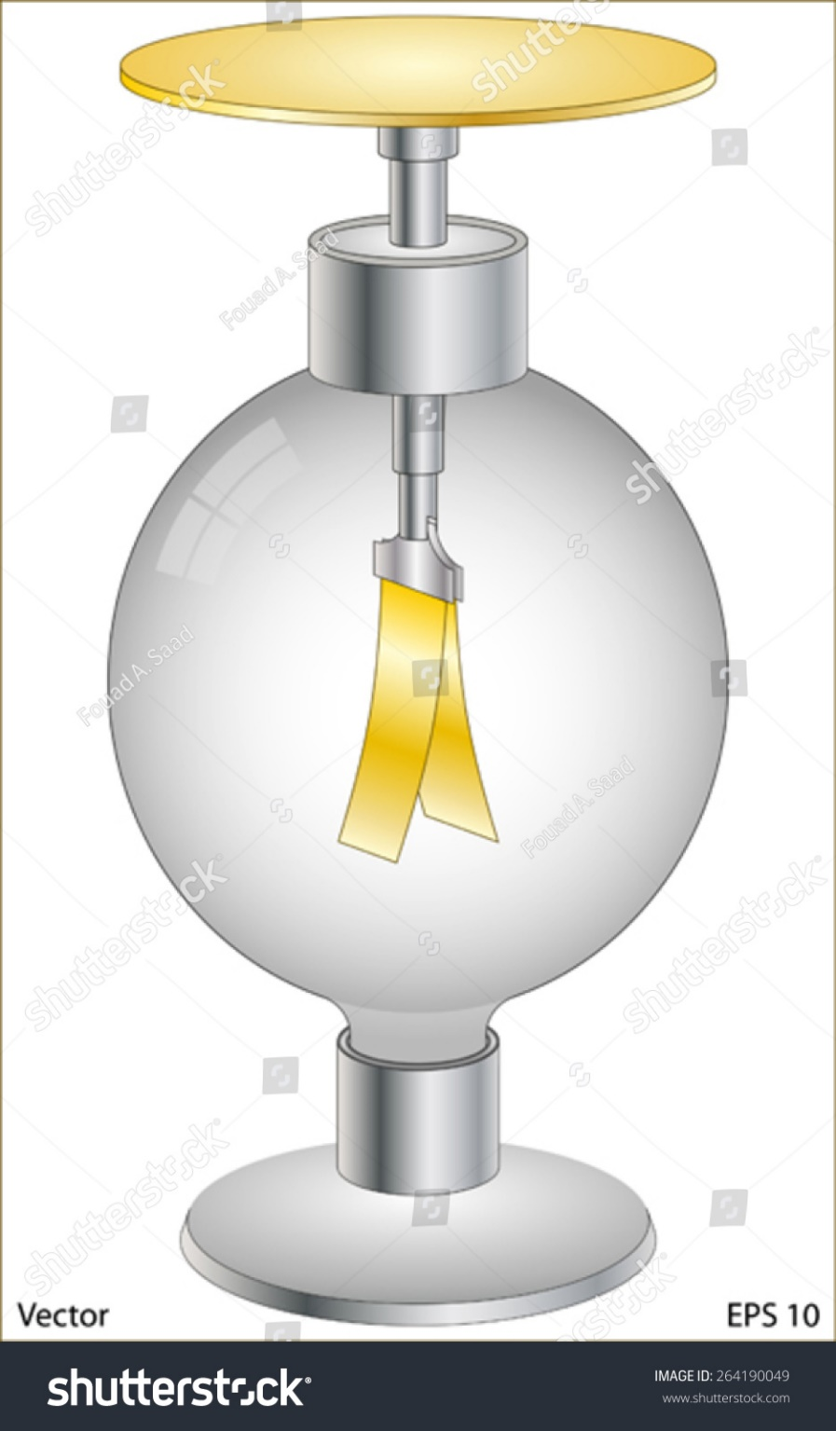
Electrical Charge
This leads directly to the concept of the “electrometer”
One of the first electrical instruments
When electric charge is applied to the plate at the top of the electrometer, it’s conducted to the two leaves
Since they’re charged the same, they repel
Note that this is independent of the polarity of the charge applied to the plate
Therefore, it can’t determine the polarity of a charge, just its magnitude

Slide 7
Current
Any charge (positive or negative) is conveyed by charge carriers
Frequently, this implies electrons
Electrons have negative charge
Specifically, one electron carries -1.602 × 10⁻¹⁹ C
Positive charge is often modeled as places that an electron wants to be, but isn’t
These places are called holes
E.g., if a BB has room for one more electron than it actually has, then it has one hole, or 1.602 × 10⁻¹⁹ C (positive charge)

Slide 8
Current
The amount of charge passing a certain point in a certain amount of time
Measured in amperes (A)
Usually abbreviated amps
Symbol: I
1 ampere = 1 coulomb per second
Water analogy: fluid flow rate; gallons/second

Slide 9

Current
Schematics often use constant-current sources
They force a constant amount of current to flow
1 A

Slide 10
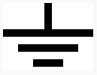
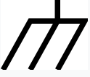
Voltage
How difficult it is to move some electrical charge from one point to another
Measured in Volts
Symbol: V (also occasionally U or E, in older documents)
Always a relative term
I.e., voltage is between two points
If not otherwise specified, voltage is assumed to be relative to the Earth (in electrical engineering) or an infinite distance away from a point charge (physics)
Generally speaking, you can choose your reference (ground) to be anything you like, and the math will work out the same
Ground or “Earth ground”:
“Chassis ground”:

Slide 11

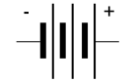
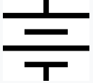
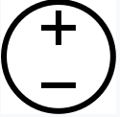
Voltage
This is the symbol for a cell:
Cells generate a constant voltage across their poles
This is the symbol for a battery:
Batteries are made up of several cells
Usually, you just use a battery symbol, with the voltage written next to it:
Alternatively, a constant voltage source symbol may be used:
12 V
12 V

Slide 12
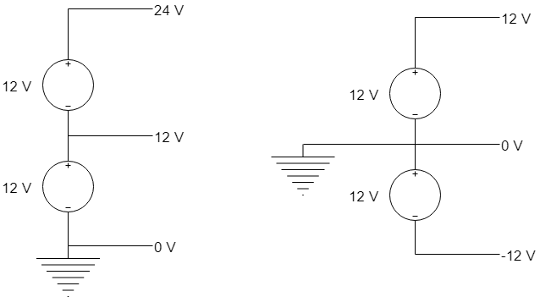
Voltage
These circuits are identical, just with different choices of ground:

Slide 13
Voltage
Water analogy:
Pressure
Similarly, pressure is usually assumed to be with respect to the atmosphere unless otherwise stated
E.g., 10 PSI is pressure above atmosphere; -10 PSI is pressure below atmosphere (i.e. vacuum)
Atmosphere is the “ground”
However, you can also just measure the pressure between two pipes, without caring about the atmosphere

Slide 14
Resistance
Resistance, as the name implies, resists or opposes the flow of current
Imagine a pipe with an orifice plate (a plate with a hole in it) in the middle
The same amount of water is flowing on both sides of the plate
However, the plate causes a pressure drop
The pressure drop is proportional to the flow rate
Higher pressure
Lower pressure

Slide 15
Resistance
Resistors are discrete components that have a certain amount of resistance
They cause a voltage (pressure) drop that is proportional to the current (flow rate)
The proportionality constant is the resistance (R)
E.g., how much voltage drop is generated per amount of current
Measured in ohms
Symbol: Ω
The ohm is defined to be 1 V/A

Slide 16

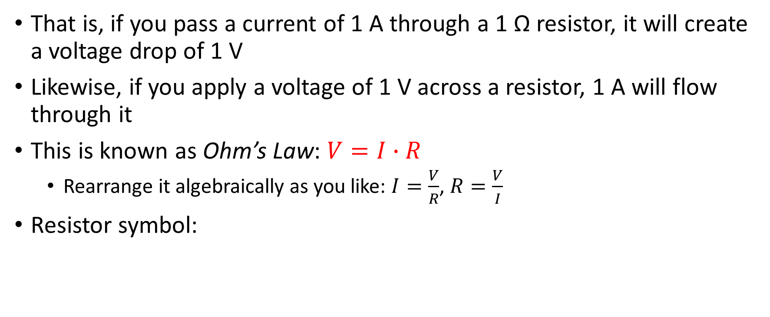
Resistance
That is, if you pass a current of 1 A through a 1 Ω resistor, it will create a voltage drop of 1 V
Likewise, if you apply a voltage of 1 V across a resistor, 1 A will flow through it
This is known as Ohm’s Law: $V=I∙R$
Rearrange it algebraically as you like: $I=\frac{V}{R}$, $R=\frac{V}{I}$
Resistor symbol:

Slide 17
Conductors & Insulators
Conductors are materials through which current can easily flow
Metals, saltwater, certain forms of carbon
Insulators do not allow current to flow through them*
Rubber, wood, air…
*Technically, they don’t allow much current to flow, i.e., they have high resistance

Slide 18
Wires
Wires are how you make current go where you want it to
They’re generally made of a metal wire (solid) or several smaller wires twisted together (stranded)
Wires are usually coated in an insulator, to keep current from going where you don’t want it to

Slide 19
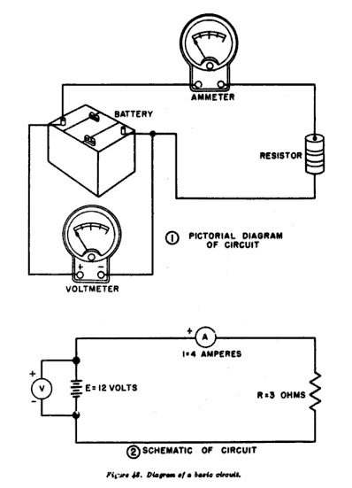
Schematics
Schematics are a way of showing how a circuit is designed
Use standard symbols for components (resistors, capacitors, etc.)
Are made up of components connected together by lines
Lines are considered perfect conductors, i.e., zero resistance

Slide 20
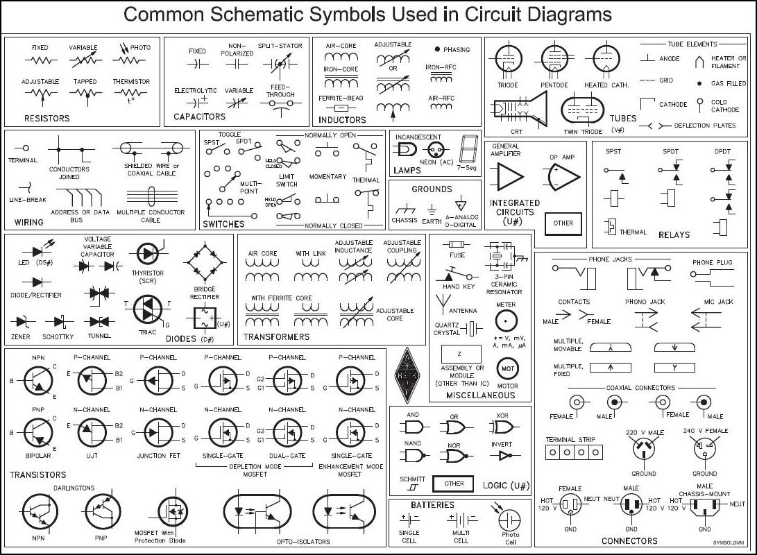
Schematics

Slide 21
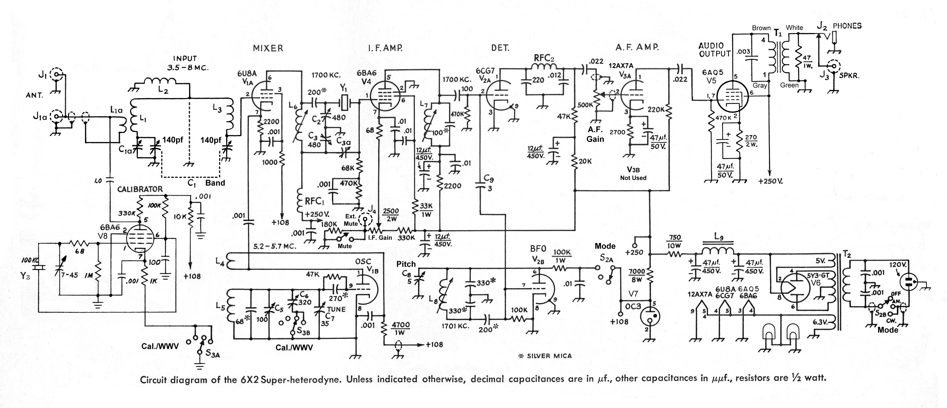
Schematics

Slide 22
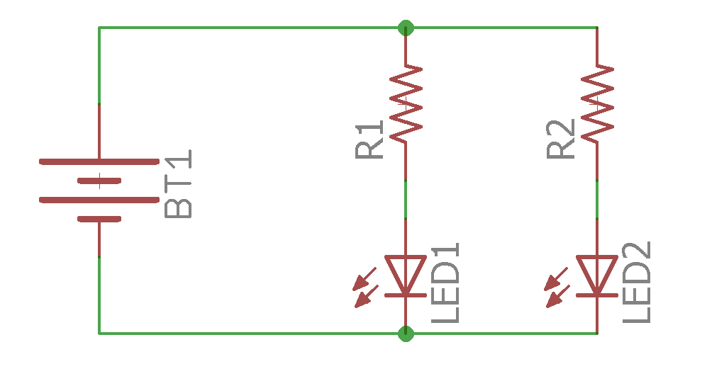
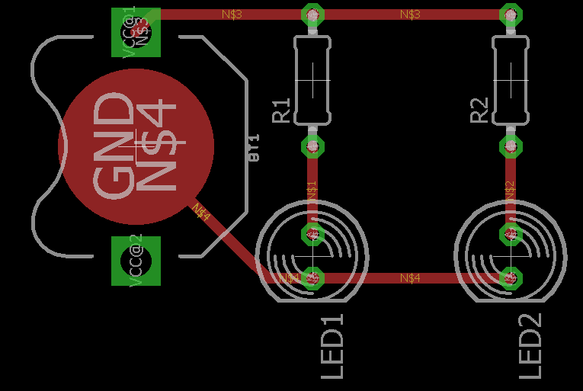
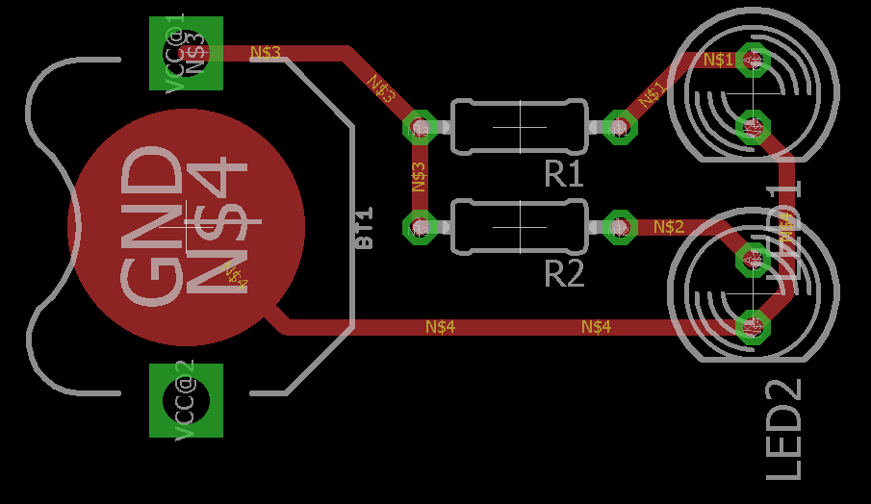
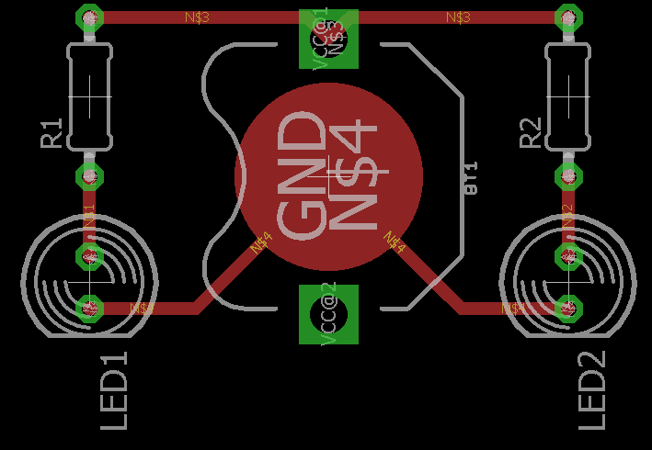
Schematics
Schematics are logical diagrams
They tell you what things are connected together
They don’t tell you how
A schematic can be implemented in different ways

Slide 23
Series and Parallel
There are two fundamental ways to connect two-terminal devices (batteries, resistors, LEDs, etc.)

Slide 24
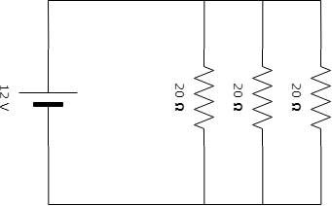
Series and Parallel
When components are connected in parallel, all of the positives are grouped, and all of the negatives are grouped
Same voltage across all devices
Possibly different currents

Slide 25
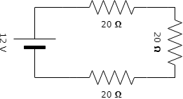
Series and Parallel
When components are connected in series, the positive of one connects to the negative of the next
Same current through all devices
Possibly different voltages

Slide 26
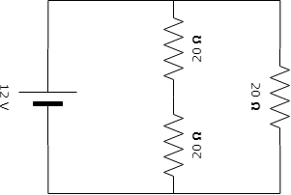
Series and Parallel
Of course, these can be combined
Here, two resistors are in series, and they are collectively in parallel with a third

Slide 27
Measuring V & I
So, how do we measure voltage and current?
With instruments called voltmeters and ammeters, respectively
Sometimes, for convenience, an ammeter and a voltmeter will be combined in one box
(Along with a bunch of other functions)
This is called a multimeter

Slide 28
Measuring V & I
Remember:
Voltage is between two points
Current is through a conductor
This suggests how voltmeters and ammeters are used

Slide 29
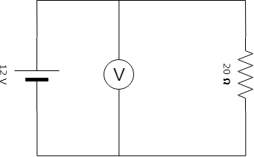
Measuring V & I
Voltmeters are attached like this:
In parallel, so that there is a voltage across them

Slide 30
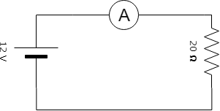
Measuring V & I
Ammeters are attached like this:
In series, so that there is current through them

Slide 31
Measuring V & I
Generally speaking, measurement instruments should not affect the thing they’re measuring
I.e, adding an ammeter to a circuit should not alter the current flowing
This suggests the ideal properties of meters:
Ammeters should have zero resistance
Voltmeters should have infinite resistance

Slide 32
Measuring R
Resistance is measured via Ohm’s Law
If you know the current going through a resistor and the voltage across it, you can calculate the resistance
There are two ways to go about this:
Apply a CV source to the resistor, and measure the current with an ammeter
Apply a CC source to the resistor, and measure the voltage with a voltmeter
The latter is preferred, because it’s a linear relationship

Slide 33
The Trouble With Sources
We’ve previously discussed constant-voltage and constant-current sources
Unfortunately, under certain circumstances, these sources are not well-behaved
12 V
1 A

Slide 34

CV Source – Pathological Case
In this case, we have a short-circuited voltage source
That is, 0 resistance between the terminals
However, there is 12 V across the terminals by definition
$I=\frac{V}{R}=\frac{12}{0}$
Infinite current is a bad sign
12 V

Slide 35

CC Source – Pathological Case
In this case, we have an open current source
That is, no current can flow between the terminals
However, there is 1 A flowing by definition
$V=IR=1∙∞$
Infinite voltage is also a bad sign
1 A

Slide 36
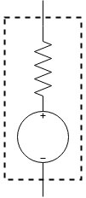
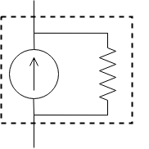
Improving Sources
In both cases, the sources can be made more realistic through the addition of resistors
The voltage source gets an internal series resistor that limits current when shorted
The current source gets an internal parallel resistor that gives the current somewhere to go when open

Slide 37
Improving Sources
Both sources can now be characterized with a finite open-circuit voltage and a finite short-circuit current
In fact, by correctly choosing the values of the source and the resistor, you can replace a CC source with a CV source that behaves the same (and vice-versa)
These are known as Thévenin’s Theorem and Norton’s Theorem, respectively

Slide 38
Batteries
In the short term, you can think of batteries as voltage sources with series resistors
That is, the more current you pull, the lower the voltage will be
Also, batteries are nonlinear even in the short term, so this is a rough approximation
However, batteries have limited capacity
Often expressed as A∙h or W∙h
A 1 A∙h battery can supply an amp for an hour before the voltage drops below some threshold
FRC batteries are 18 A∙h
So it would seem that you could draw more than 400 A for the duration of an FRC match

Slide 39
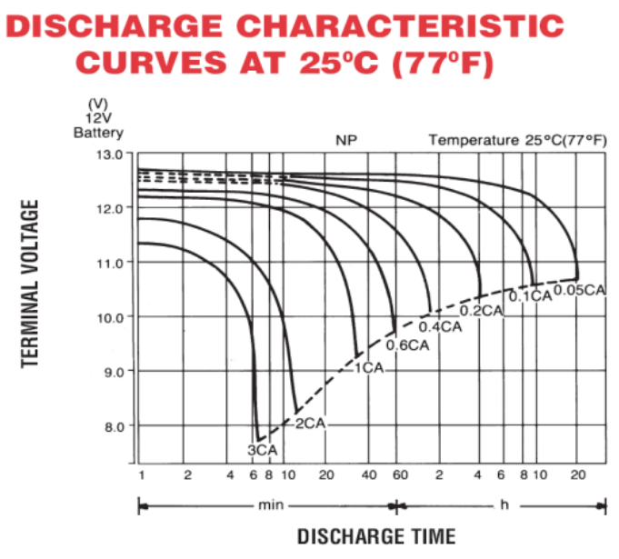
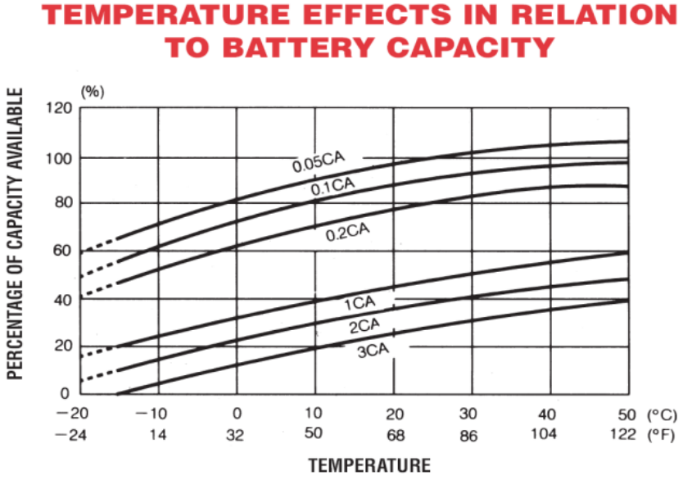
Batteries
Plots are labelled as CA, Capacity in Amps (18, in this case)
Note that the capacity of the battery is lower the faster you use it up

Slide 40
Power
“Energy per time”
For example, water has a specific heat of ~1055 J lbm⁻¹ °F⁻¹
In other words, you need 1055 joules of energy to heat up a pound of water by 1 degree Fahrenheit
Power is measured in watts (1 joule per second)
Less commonly, horsepower or BTU per hour
If you have a heater that can put out 1 W, it will take you 1055 seconds to heat up a pound of water by 1 °F
Likewise, a 100 W heater will do it in ~10.5 seconds

Slide 41

Power
In electrical terms, power is the product of voltage and current
$P=I∙V$
Commonly formulated as $P=I^{2}∙R$
Easily found by combining $P=I∙V$ with Ohm’s Law

Slide 42
Power
Power is a signed quantity; it can be positive or negative
By convention, things which dissipate power (heaters, motors, etc.) have positive power
Things which supply power (batteries, generators) have negative power

Slide 43

Power
Power is important for two reasons
Conservation of energy
DC/DC converters are used to convert electricity at one voltage to another voltage
If you have 1 A at 12 V (12 W) going into a 12->5 DC/DC converter, you can get no more than 2.4 A at 5 V (12 W) out of it
Most components have power limits
A 10 Ω resistor rated at 0.25 W could handle ~160 mA $\left(\sqrt{\frac{P}{R}}=\sqrt{\frac{0.25}{10}}≈0.158\right)$
If you try to run an amp through it, it will burn up $\left(I^{2}R=1^{2}∙10=10≫0.25\right)$
In most cases, this is a thermal constraint; dissipating more heat requires a higher temperature, and components have maximum temperatures

Slide 44
I-V Plots
Plots of current vs. voltage
Current is considered positive if it flows from the positive pole of a component to the negative pole
In this circuit, the battery is seeing negative current, and the resistor is seeing positive current
+
-

Slide 45
I-V Plots

Slide 46
I-V Plots
Remember: P=IV

Slide 47
Variable Power Supplies
Most benchtop power supplies have knobs to adjust voltage and current
This frequently causes confusion
“The current knob isn’t changing the current”
“There are CC and CV lights. How do I put it into CC mode?”
The knobs do not adjust the voltage and current
They adjust the voltage and current limits

Slide 48
Variable Power Supplies
That is, for a power supply set to 6 V and 4 A, the limits look like this:

Slide 49
Variable Power Supplies
Where the load line (I-V plot of the stuff connected to the power supply) intersects the power supply line is the operating point of the power supply
E.g., suppose we have a 2 Ω resistor connected to the power supply

Slide 50
Variable Power Supplies
Operating point is here
(6 V, 3 A)

Slide 51
Variable Power Supplies
This is called CV (constant voltage) mode, because the operating point is at the voltage limit
Note that adjusting the current knob won’t do anything at this point, because the operating point is not on the current limit
Operating point is here
(6 V, 3 A)

Slide 52
Variable Power Supplies
However, if we decrease the current limit below 3 A…
Operating point is here
(4 V, 2 A)

Slide 53
Variable Power Supplies
Now power supply is in CC (constant-current) mode
Operating point is here
(4 V, 2 A)

Slide 54
Variable Power Supplies
Important: power supply knobs adjust the voltage & current limits, but power supply displays show the actual voltage & current
Thus, when in CV mode (not at the current limit), the current display will not be showing the current limit
Vice-versa for CC mode

Slide 55
Variable Power Supplies
Normal procedure:
With nothing connected to PS terminals (infinite resistance → CV mode), adjust voltage knob to the desired voltage limit
Short out PS terminals with a banana jumper (zero resistance → CC mode)
Adjust current knob to the desired current limit
Remove jumper and connect load
Note: some higher-end power supplies can display the actual V & I as well as the V & I limits on one screen
Others have a button to short out the power supply internally

Slide 56
Variable Power Supplies
Important: The previous applies only to variable benchtop power supplies
Many specialized power supplies (in computers, wall warts, etc.) are designed to work in a narrow range of voltages and currents
Very Bad Things can happen if you short them out

Slide 57
LED
Maximum current specified by datasheet
Typical I-V plot for a high-power LED

Slide 58
LED
Generally, we want to squeeze as much light as we can out of an LED, without burning it up
The power supplied to the LED must be dissipated
More power requires higher temperature to dissipate
Excess power increases the thermal equilibrium of the diode past the maximum temperature
This kills the diode
Therefore, we want to keep the operating point close to the power limit, but not over it
To achieve this, we can:
Use a power supply that tries to maintain a specified voltage (voltage source)
Use a power supply that tries to maintain a specified current (current source)

Slide 59
LED
To stay in this section of the curve, we can either:
Maintain voltage between 3.177 V and 3.200 V, OR
Maintain current between 0.944 A and 1.000 A
Voltage control requires PS accuracy of 0.7%
Current control requires PS accuracy of 5.6%
This is why constant-current power supplies are usually used to drive large LEDs
Current control requires less accuracy than voltage control

Slide 60
Kirchoff’s Laws
Two different laws fundamental to DC circuit analysis
First law: The sum of currents entering a junction must be zero
Second law: The sum of all voltage drops around a loop must be zero

Slide 61
Kirchoff’s Laws
A loop is a continuous path through which current can flow
It does, in fact carry some current; the loop current
(Although this can be zero)
Note that multiple loops can pass through a given wire or component
Loop with 1 A
Loop with 1 A
Therefore this component carries 2 A

Slide 62


Kirchoff’s Laws
Simple circuit with one loop:
(12)
+(-V_{R})
=0
+
V_{R}=12
V_{R}
For a resistor: $V=I∙R$
-
$$12=I∙1$$

Slide 63
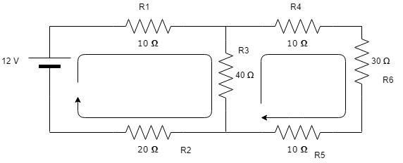

Kirchoff’s Laws
Slightly more complex example:
Goal: find $I_{R_{1}}$ and ${I_{R}}_{3}$

Slide 64

Kirchoff’s Laws
From Kirchoff’s 2nd law:
$12−\left(R_{1}I_{ℓ1}\right)−\left(R_{3}⋅\left(I_{ℓ1}−I_{ℓ2}\right)\right)−\left(R_{2}I_{ℓ1}\right)=0$
$−\left(R_{3}⋅\left(I_{ℓ2}−I_{ℓ1}\right)\right)−\left(R_{4}I_{ℓ2}\right)−\left(R_{6}I_{ℓ2}\right)−\left(R_{5}I_{ℓ2}\right)=0$
We have two unknowns ($I_{ℓ1}, I_{ℓ2}$) and two equations, so we should be able to solve:
E1: $12−\left(R_{1}I_{ℓ1}\right)−\left(R_{2}I_{ℓ1}\right)=R_{3}⋅\left(I_{ℓ1}−I_{ℓ2}\right)$
E2: $−\left(R_{4}I_{ℓ2}\right)−\left(R_{6}I_{ℓ2}\right)−\left(R_{5}I_{ℓ2}\right)=R_{3}⋅\left(I_{ℓ2}−I_{ℓ1}\right)$
Invert E2: $\left(R_{4}I_{ℓ2}\right)+\left(R_{6}I_{ℓ2}\right)+\left(R_{5}I_{ℓ2}\right)=R_{3}⋅\left(I_{ℓ1}−I_{ℓ2}\right)$
Combine: $12−\left(R_{1}I_{ℓ1}\right)−\left(R_{2}I_{ℓ1}\right)=R_{3}⋅\left(I_{ℓ1}−I_{ℓ2}\right)=\left(R_{4}I_{ℓ2}\right)+\left(R_{6}I_{ℓ2}\right)+\left(R_{5}I_{ℓ2}\right)$
Sub in actual values: $12−30⋅I_{ℓ1}=40⋅\left(I_{ℓ1}−I_{ℓ2}\right)=50⋅I_{ℓ2}$
$I_{ℓ1}≈0.230, { I}_{ℓ2}≈0.102$
${I_{R}}_{1}=I_{ℓ1}≈0.230, {I_{R}}_{3}=I_{ℓ1}−I_{ℓ2}≈0.128$in the $ℓ_{1}$ direction (or -0.128 in the $ℓ_{2}$ direction)

Slide 65
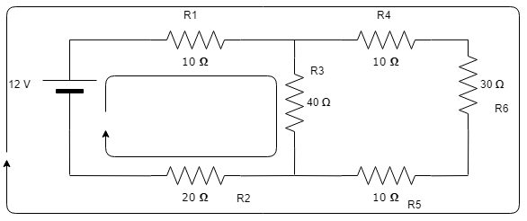
Kirchoff’s Laws
The specific loops you choose don’t matter!
Basically, as long as each component and wire has at least one loop passing through it, you can solve the circuit

Slide 66

Kirchoff’s Laws
From Kirchoff’s 2nd law:
$12−\left(R_{1}⋅(I_{ℓ1}+I_{ℓ2}\right))−\left(R_{3}I_{ℓ1}\right)−\left(R_{2}⋅(I_{ℓ1}+I_{ℓ2}\right))=0$
$12−\left(R_{1}⋅(I_{ℓ1}+I_{ℓ2}\right))−\left(R_{4}I_{ℓ2}\right)−\left(R_{6}I_{ℓ2}\right)−\left(R_{5}I_{ℓ2}\right)−\left(R_{2}⋅(I_{ℓ1}+I_{ℓ2}\right))=0$
We have two unknowns ($I_{ℓ1}, I_{ℓ2}$) and two equations, so we should be able to solve:
E1: $12−\left(R_{3}I_{ℓ1}\right)=R_{1}⋅(I_{ℓ1}+I_{ℓ2})+R_{2}⋅(I_{ℓ1}+I_{ℓ2}$)
E2: $12−\left(R_{4}I_{ℓ2}\right)−\left(R_{6}I_{ℓ2}\right)−\left(R_{5}I_{ℓ2}\right)=R_{1}⋅\left(I_{ℓ1}+I_{ℓ2}\right)+R_{2}⋅(I_{ℓ1}+I_{ℓ2})$
Combine: $12−\left(R_{3}I_{ℓ1}\right)=R_{1}⋅\left(I_{ℓ1}+I_{ℓ2}\right)+R_{2}⋅\left(I_{ℓ1}+I_{ℓ2}\right)=12−\left(R_{4}I_{ℓ2}\right)−\left(R_{6}I_{ℓ2}\right)−\left(R_{5}I_{ℓ2}\right)$
Sub in actual values: $12−\left(40⋅I_{ℓ1}\right)=30⋅\left(I_{ℓ1}+I_{ℓ2}\right)=12−\left(50⋅I_{ℓ2}\right)$
$I_{ℓ1}≈0.128, { I}_{ℓ2}≈0.102$
${I_{R}}_{1}=I_{ℓ1}+I_{ℓ2}≈0.230, {I_{R}}_{3}=I_{ℓ1}≈0.128$

